Slide 1


Paper: Distributed Attribute-Based Access Control System Using a Permissioned Blockchain
Phạm Nguyễn Hải Anh
Nguyễn Lê Thảo Ngọc

Slide 2
INTRODUCTION
1

Slide 3
Paper info
1. Paper Name: Distributed attribute-based access control system using permissioned blockchain
2. Authors: Sara Rouhani - Rafael Belchior - Rui S. Cruz - Ralph Deters
3. Published Year: 2021
4. Journal: World Wide Web - Springer
2

Slide 4

Scenario, Objective
Flexible + fine-grained + distributed
Auth
User’s attribute
Allow/Deny
Org
Request Obj
(Obj)
Trusted Audit
3

Slide 5
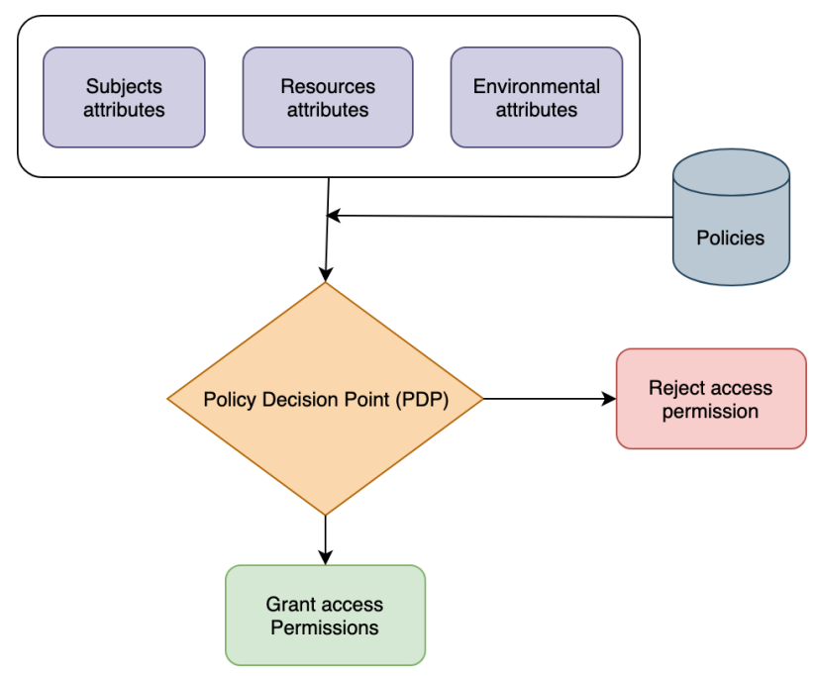
Technology used
Attribute-based Access Control
Permissioned Blockchain:
Policy -> Smart contract
Transparent
Immutable
Distributed
=> Hyperledger Fabric
4

Slide 6
BACKGROUND
5

Slide 7
Access control systems
Authorization: <o, s, p> - subject s has privilege p for object o
Labeled resource
attributes
DAC
MAC
RBAC
ABAC
rule for SID
role for user
6

Slide 8
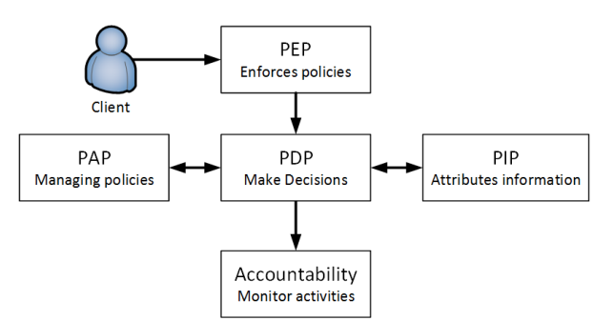
ABAC logical components
7

Slide 9

ABAC system example
Name Gender DateOfBirth Faculty ID Address
attributes
compare
Policy 1
Policy 2
...
Policy n
Accept
Request resource 1
System
Resource 1
employee
Fine-grained
Flexible
8

Slide 10
SYSTEM MODEL AND ARCHITECTURE
9

Slide 11
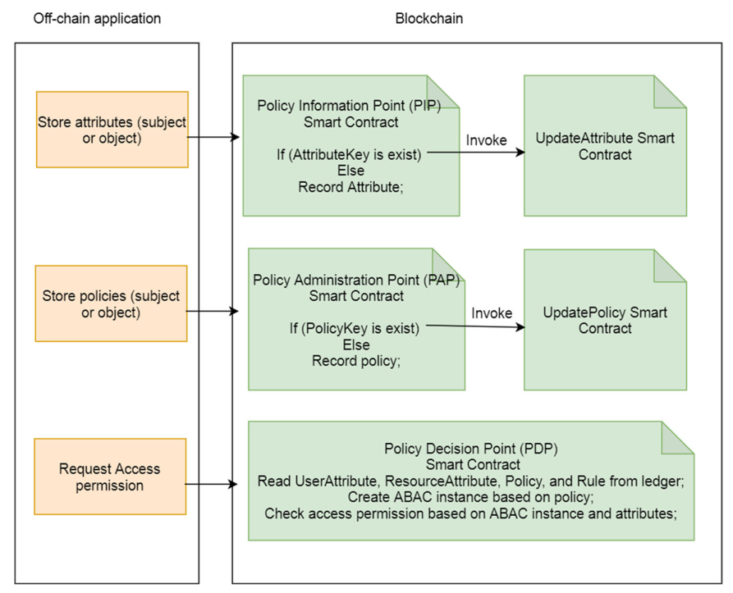
Smart contracts
11

Slide 12
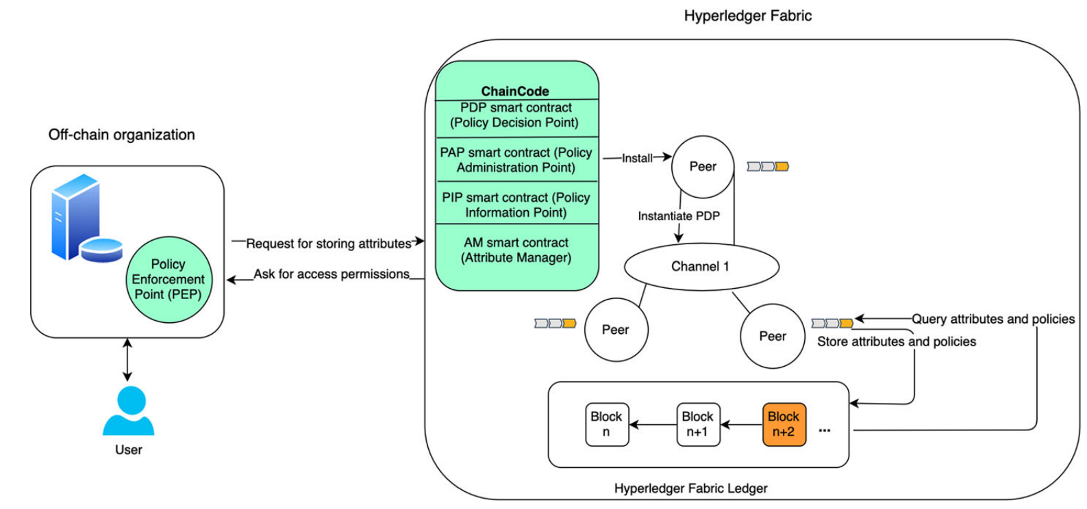
System architecture
10

Slide 13
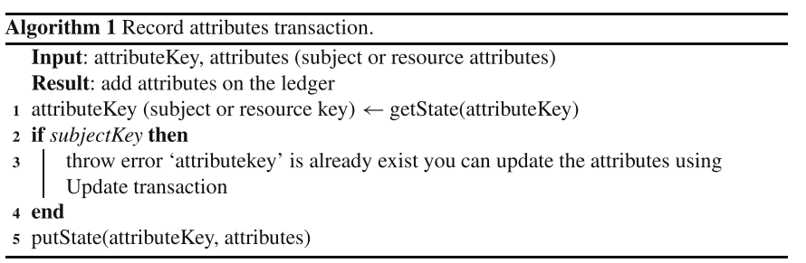
Algorithms
Algorithm 1 shows how the list of resources and subjects attributes are stored in the ledger.
12

Slide 14
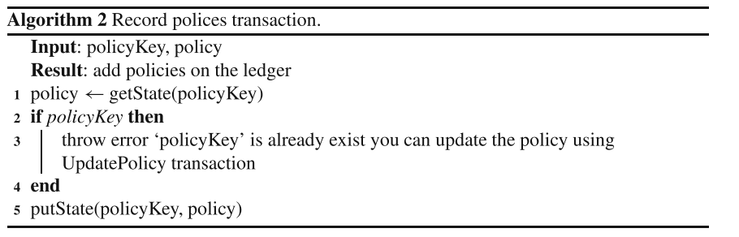
Algorithms
Algorithm 2 presents how policies are recorded in the ledger.
13

Slide 15
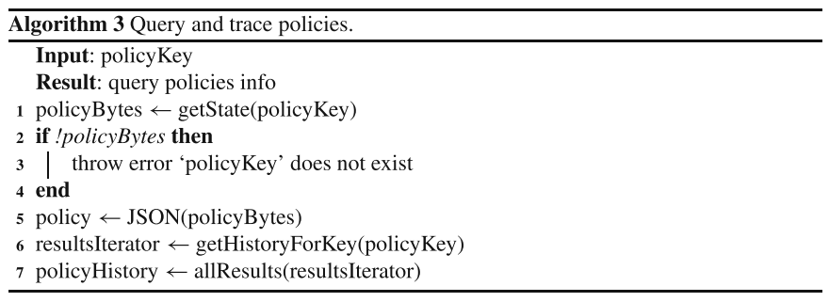
Algorithms
Algorithm 3 explains how to query policies and the history of changes to the policies from​the ledger.
14

Slide 16
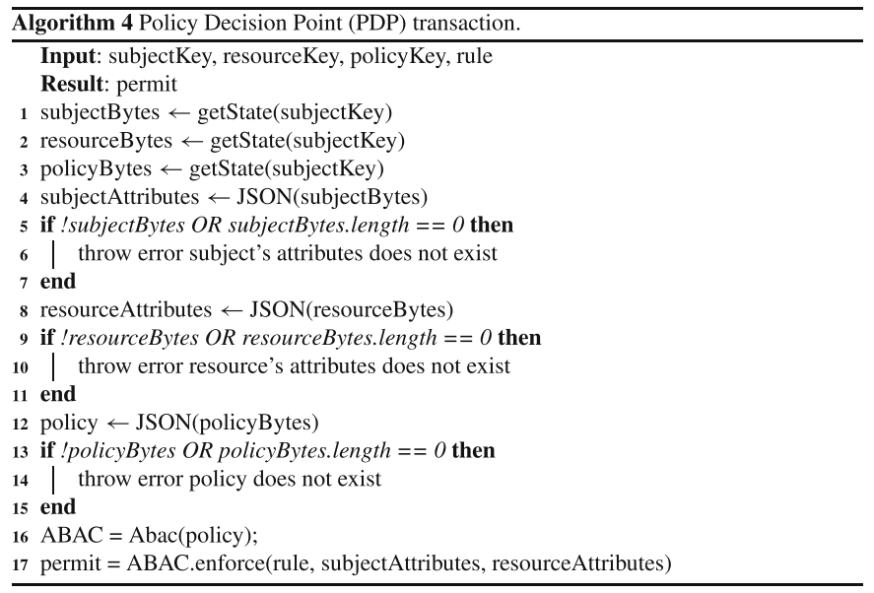
Algorithms
Alg 4 shows the detailed implementation of the PDP transaction,which includes querying the relevant attributes and policies from the ledger and making a decision based on their values.
15

Slide 17
CASE STUDY
16

Slide 18
Digital library
CouchDB and Level DB: key-value stores
A subject ⬄ SID:set of att-value
A Object ⬄ OID:set of att-value
S_{n}A = {
S_{n}ID, {
{ S_{n}A₁, value},
...,
{ S_{n}A_{n}, value}
}
}
O_{n}A = {
O_{n}ID, {
{ O_{n}A₁ , value},
...,
{ O_{n}A_{n}, value}
}
}
17

Slide 19
Digital library
policy = {
‘‘policy ID’’: ‘‘policy01’’,
attributes : {
‘‘user’’:{
‘‘status’’: ‘‘Active’’,
‘‘ expiration’’:‘‘Date of expiration’’,
‘‘ libraryGroup’’:‘‘Group ID’’
},
‘’resource’’:{
‘‘libraryGroup’’:‘‘Group ID’’}
},
‘‘rules’’:{
‘‘user.status’’:{
‘‘comparison type’’: ‘‘boolean ’’,
‘‘ comparison’’: ‘‘boolAnd’’,
‘‘ value’’:true},
‘‘user.expiration’’: {
‘‘comparison type’’: ‘‘datetime’’,
‘‘comparison’’: ‘‘isMoreRecentThan ’’,
‘‘value’’: ‘‘1DAY’’
},
‘‘user.libraryGroup’’: {
‘‘comparisontarget’’: ‘‘libraryGroup’’,
‘‘comparison type’’: ‘‘numeric’’,
‘‘comparison’’: ‘‘is stricly equal ’’,
‘‘field’’: ‘‘resource.libraryGroup’’
}
}
}
}
S₁A = {“s001”, {“status”, true}, {“expiration”, “2020− 05 − 12”}, {“libraryGroup”, 12}}
O₁A = {“r001”, {“libraryGroup”, 12}}
Policy P1 with id “policy01”: P1 = {“policy01”, S₁A, O₁A, {“status == true” ∧ “expiration” > “1Day” ∧ “user.libraryGroup” == “resource.libraryGroup”}}
18

Slide 20
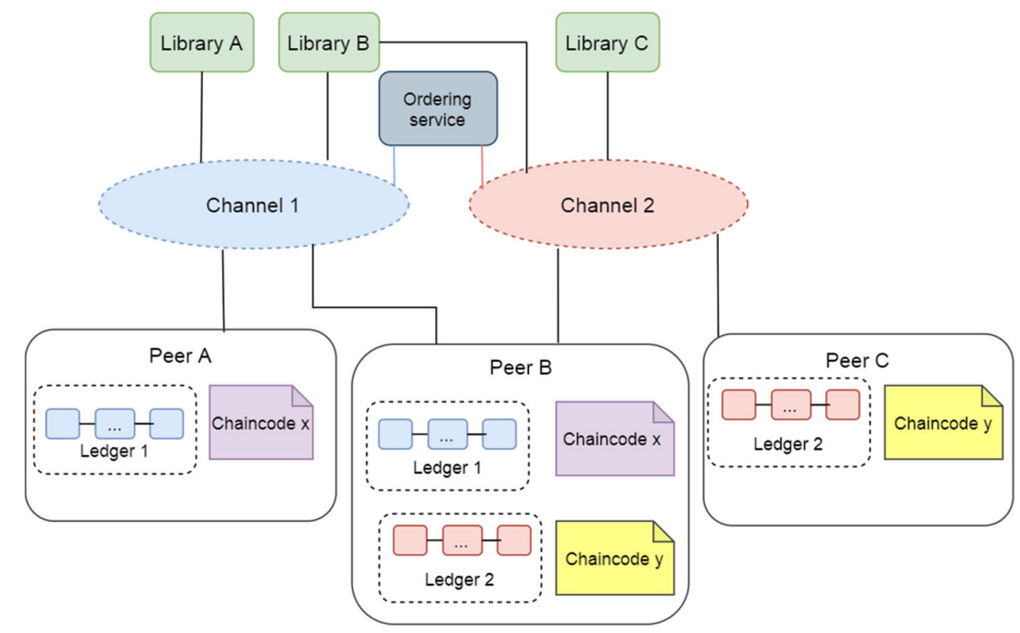
Digital library

Slide 21
SYTEM EVALUATION
19

Slide 22
Configuration
+ A vm on Google Cloud: 8 CPUs, ram 8GB, n2-highcpu-8
+ Kafka, Raft supported in Fabric (Caliper benchmark)
+ Subject, Object attribute and policies format: json
+ clients in blockchain network: 10
+ Txs: 5000
+ Default orgs: 2
+ Default peer: 1
20

Slide 23
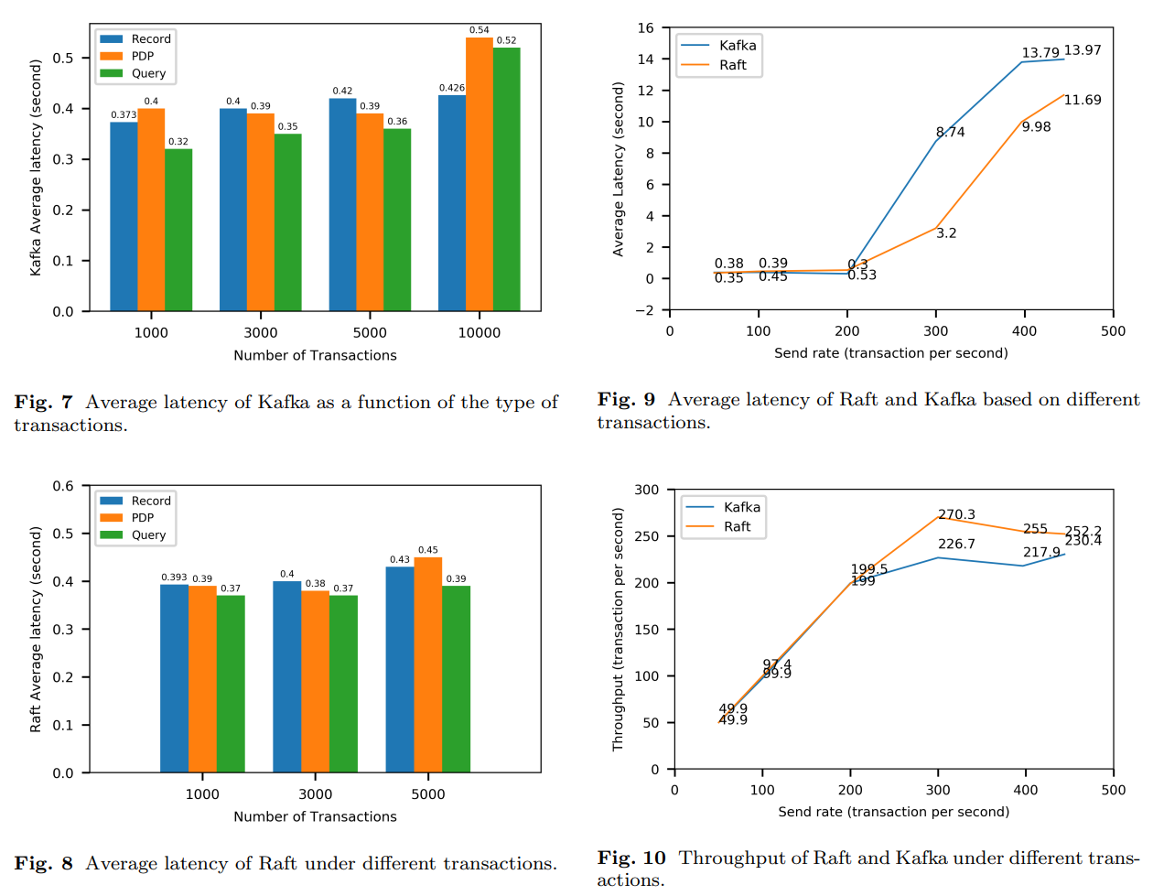
21

Slide 24
Demo
22

Slide 25
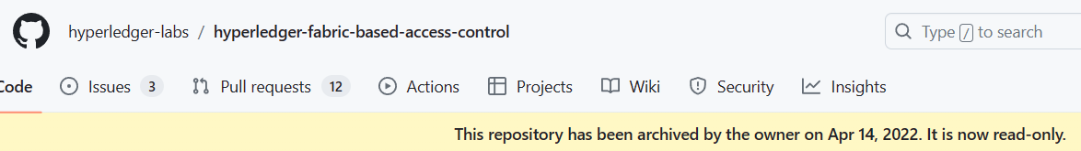
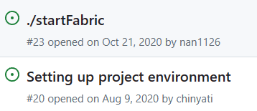
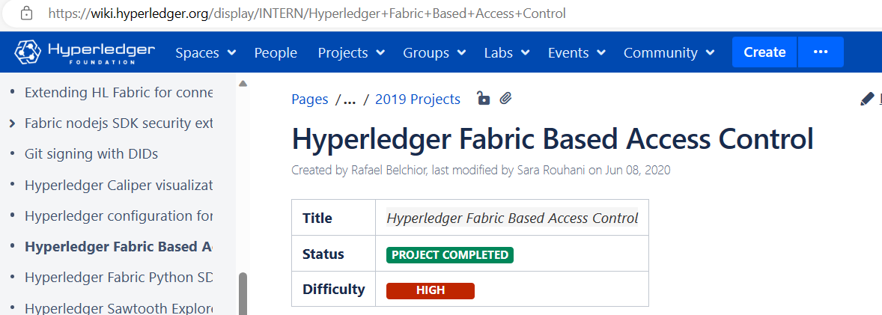
Paper’s source code
Git:
Project in Hyperledger:
23

Slide 26
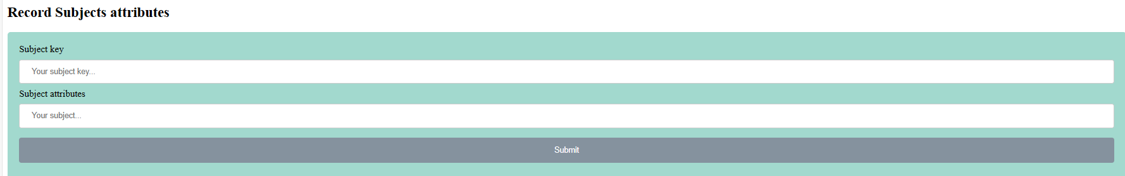
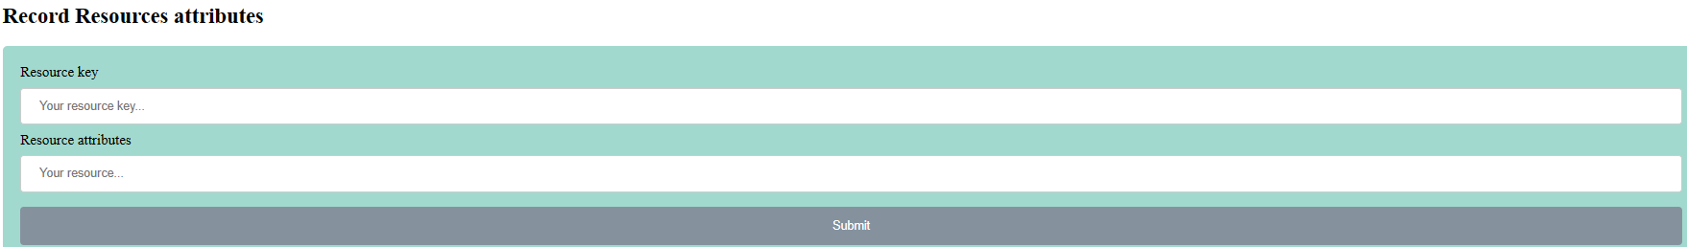
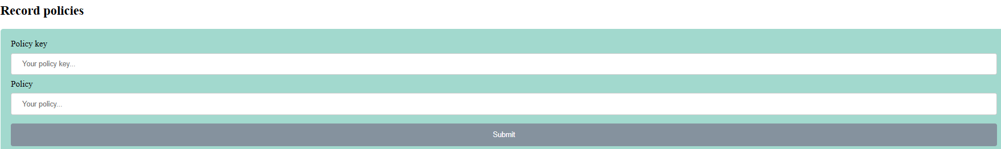
Paper’s source code
Web-UI:
23

Slide 27
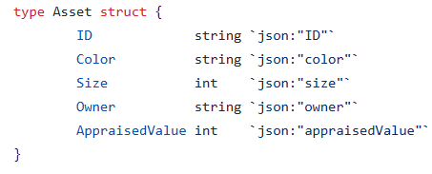
Fabric-samples ABAC
Smart Contract:
Function:
CreateAsset()
UpdateAsset()
DeleteAsset()
TransferAsset()
ReadAsset()
GetAllAssets()
AssetExists()
GetSubmittingClientIdentity()

Slide 28
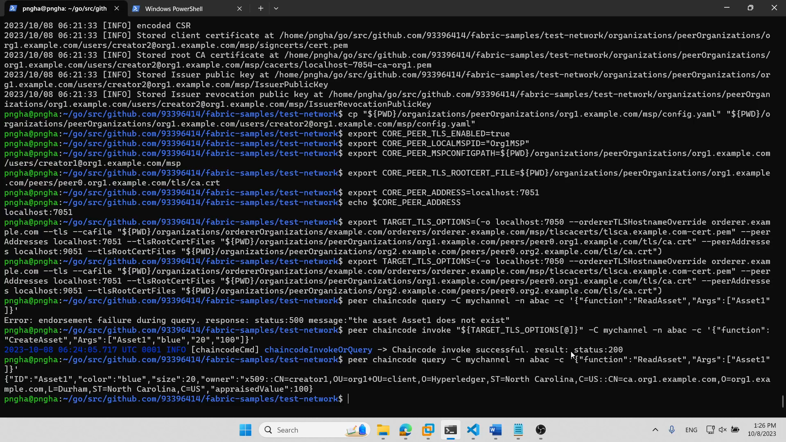

Slide 29
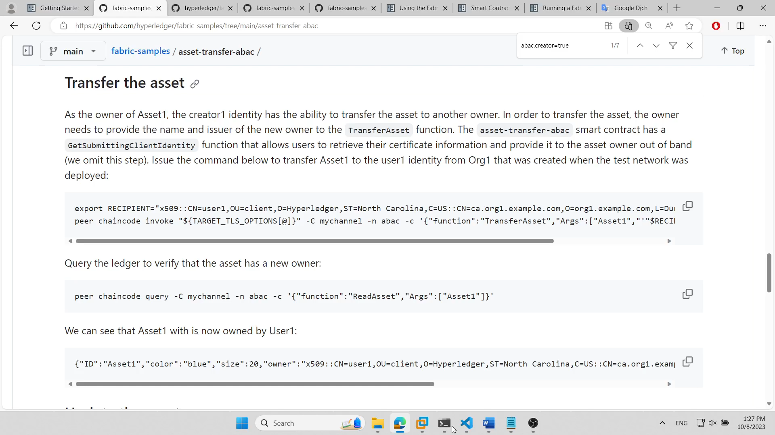

Slide 30
Future work
Research and benchmark Fabric-samples’ ABAC
Compare with the paper’s evaluation

Slide 31
THANK YOU

Slide 32


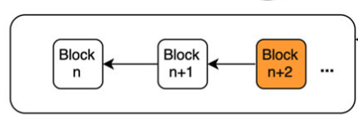

System architecture
Off-chain
PIP
AM
PAP
Off-chain
Query attributes
Query policies
PDP
Reply
Data sharing
Request
PEP
Store
Attributes, Policies
Owner
Query
Attributes, Policies
Hyperledger Fabric blockchain
User
10

